Slide 1
Problems with Superior Rectus recession
Squint Club NZ 2012
Orly Halachmi
Lionel Kowal

Slide 2
Different mechanisms of problems
1. Slips in month 2 because Sup obl is in the way
2. Slips on day 2
3. slips in month 2, not sure why
4. after blowout

Slide 3
Case 1: KE, 65yo
40 yrs ago: closed head injury. No LOC.
6 y ago: another ophthalmologist. 16Δ LH. LIO myectomy.
3 w post op 8Δ LH. Pt recalls no change to diplopia or head tilt.
Now c/o : vertical diplopia & head tilt [giving neck pain]
MRI: atrophic LSO
Up right LH 8 ‘8’ c.f. ‘20+’ reflects the IO- surgery | Up X6 | Up left LH 10
Right LH 16 | Primary LH 16 | Left LH 16
Down right LH 20+ LSO UA | Down 0 | Down left LH 14 ‘14’ c.f. ‘10’ reflects tight LSR
L tilt LH 30 reflects L SOP & tight LSR | R tilt LH 4
Head tilt R 15 ° | 15Δ BD LE small range single vision | LIO+, LSO-, LIR-

Slide 4
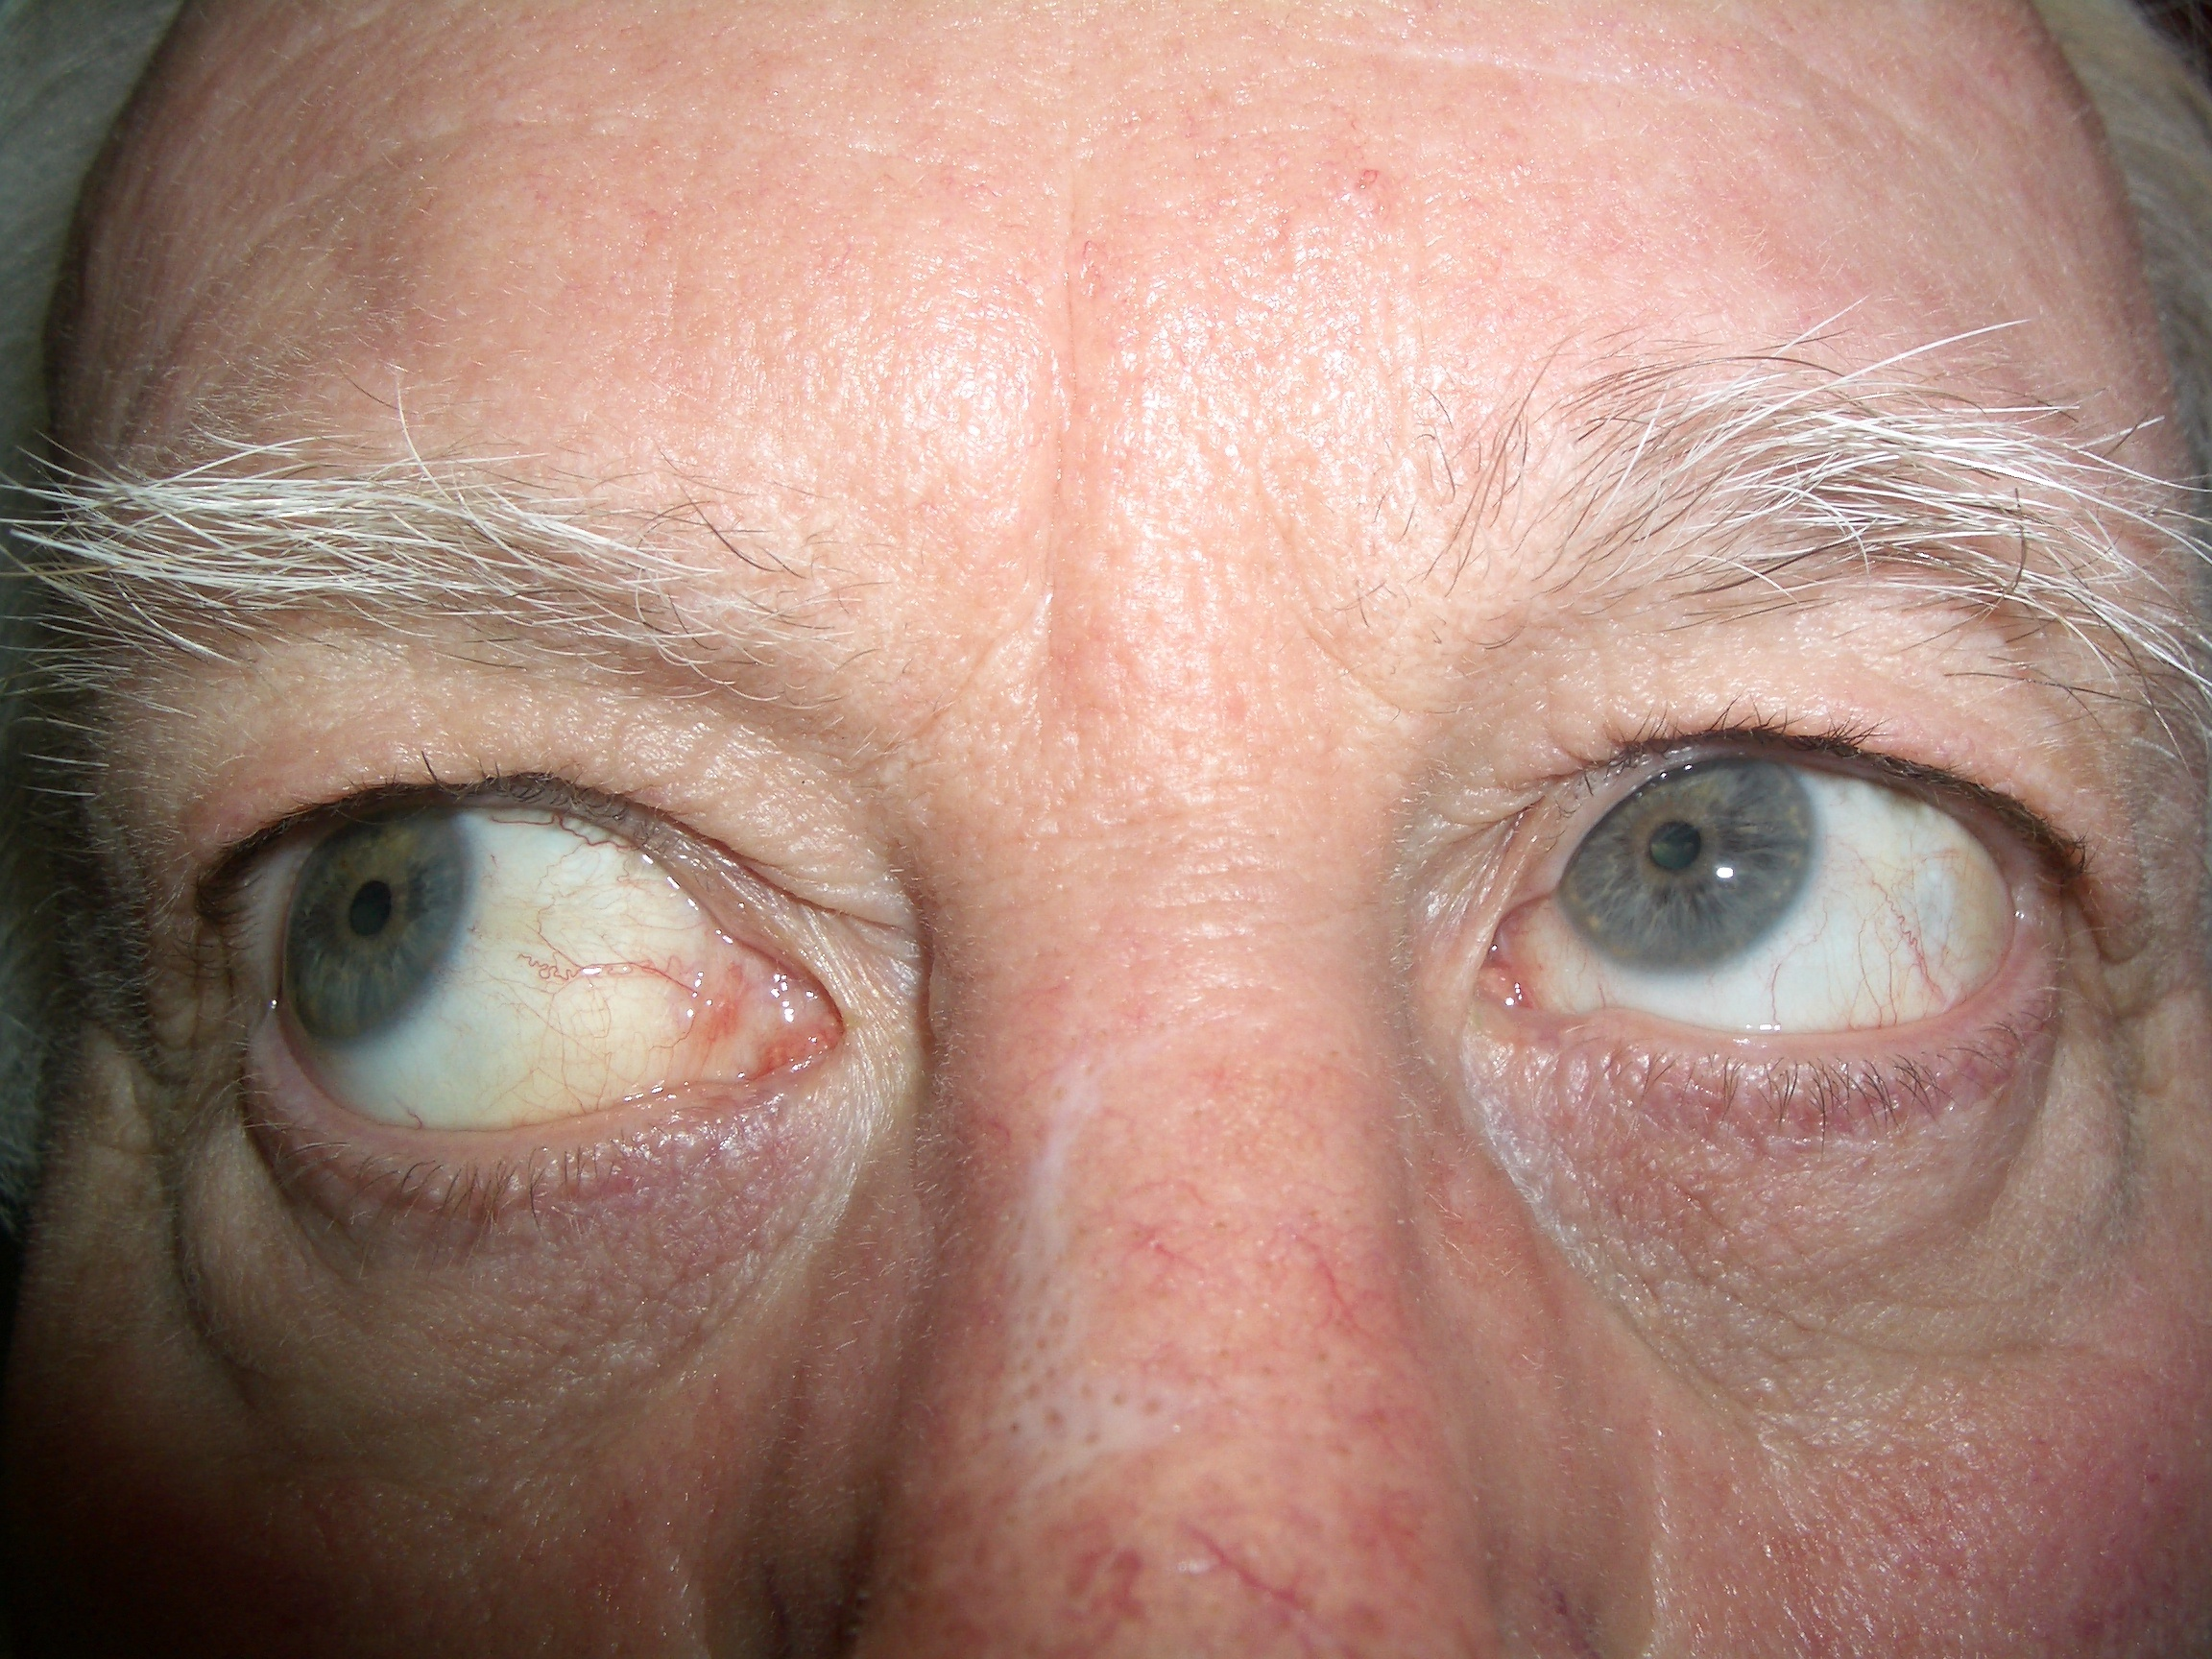
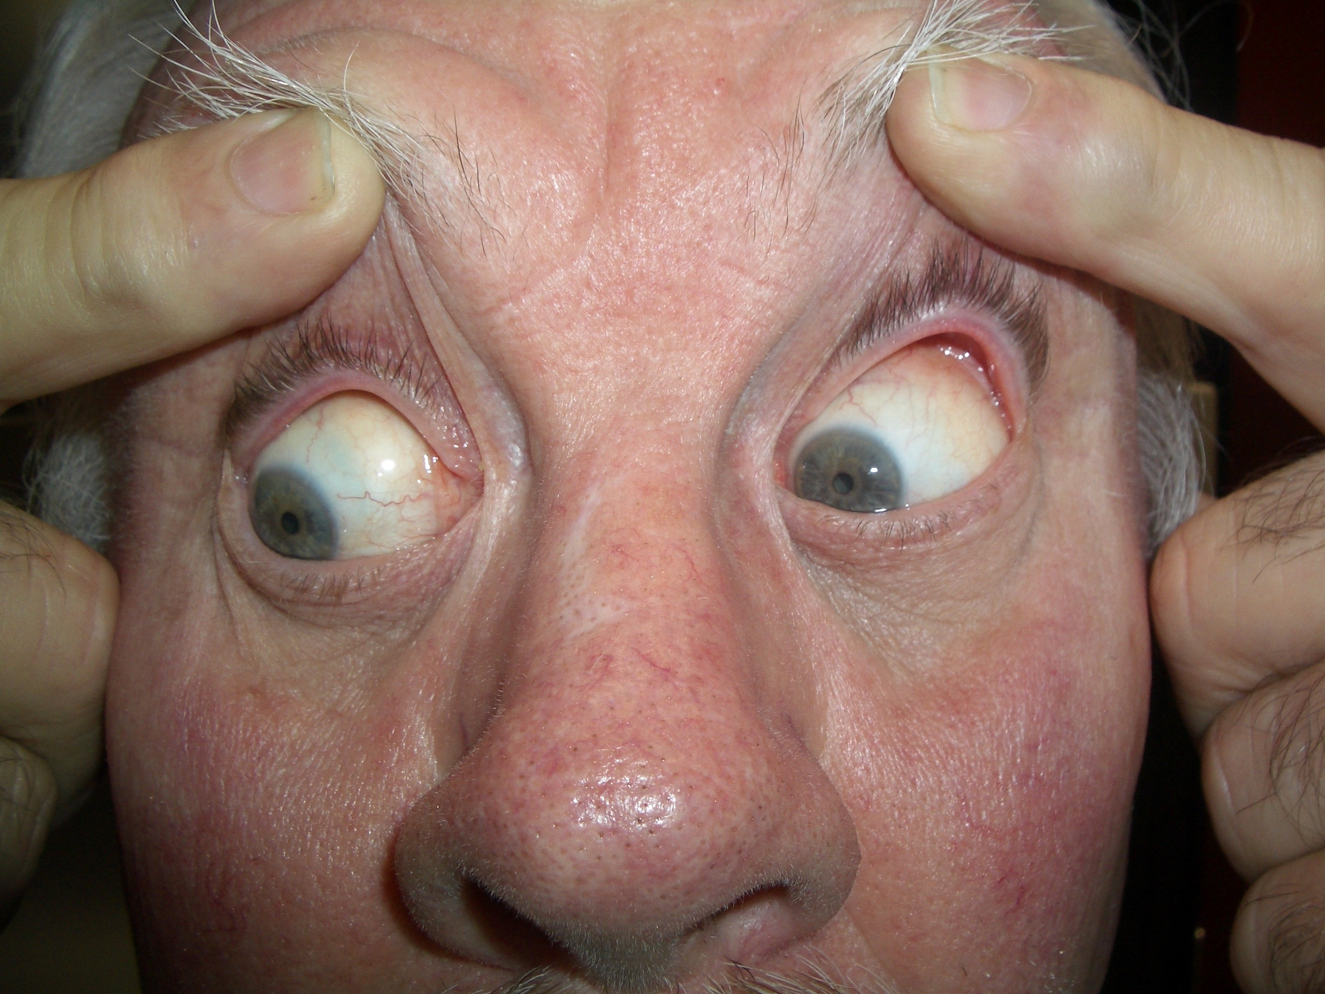
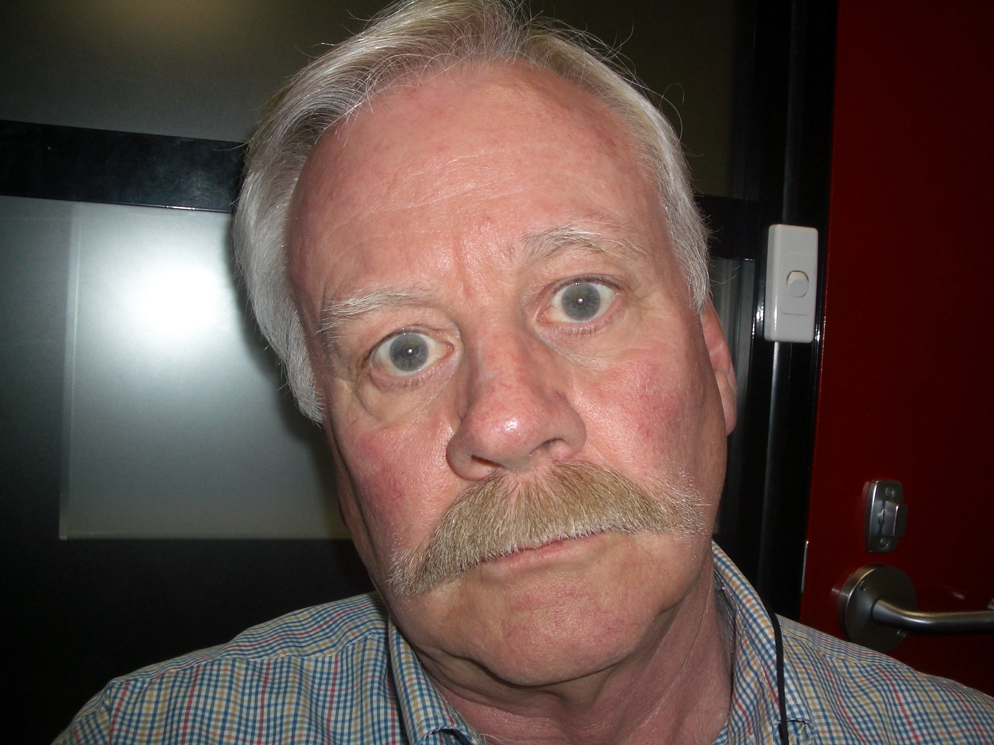
LIO OA
LSO UA
Operation notes [July 22]:
Findings on FDT: LSO not floppy.LSR tight
Surgery: LSR recess 3mm, transposed temporally to edge of insertion, adjustable, 6/0 vicryl
RIR recess 3mm, fixed, 6/0 Mersilene

Slide 5
KE: Operation notes [July 22]:
Findings on FDT: LSO not floppy. LSR tight.
Surgery: LSR recessed 3mm, transposed temporally to edge of insertion, adjustable, 6/0 vicryl
RIR recess 3mm, fixed, 6/0 Mersilene
S/conj dexamethasone. Topical Betadine, Voltaren
Adjustment on D1:
LH 8-10Δ. LSR re-recessed X2 to ortho, no diplopia

Slide 6
KE – great early outcome
R gaze: RH 5 was LH 16 | Primary:LH2 was LH 16 | L gaze: LH6 was LH 16
D1 post op:
Fuses 4 dot
Vertical fusion range in primary: BD R3Δ, BD L2Δ. Horizontal ± 4Δ
W5 postop:
100” Titmus
Vertical fusion range in primary: ±3Δ. Horizontal – 4 to +10Δ
Large range single vision

Slide 7
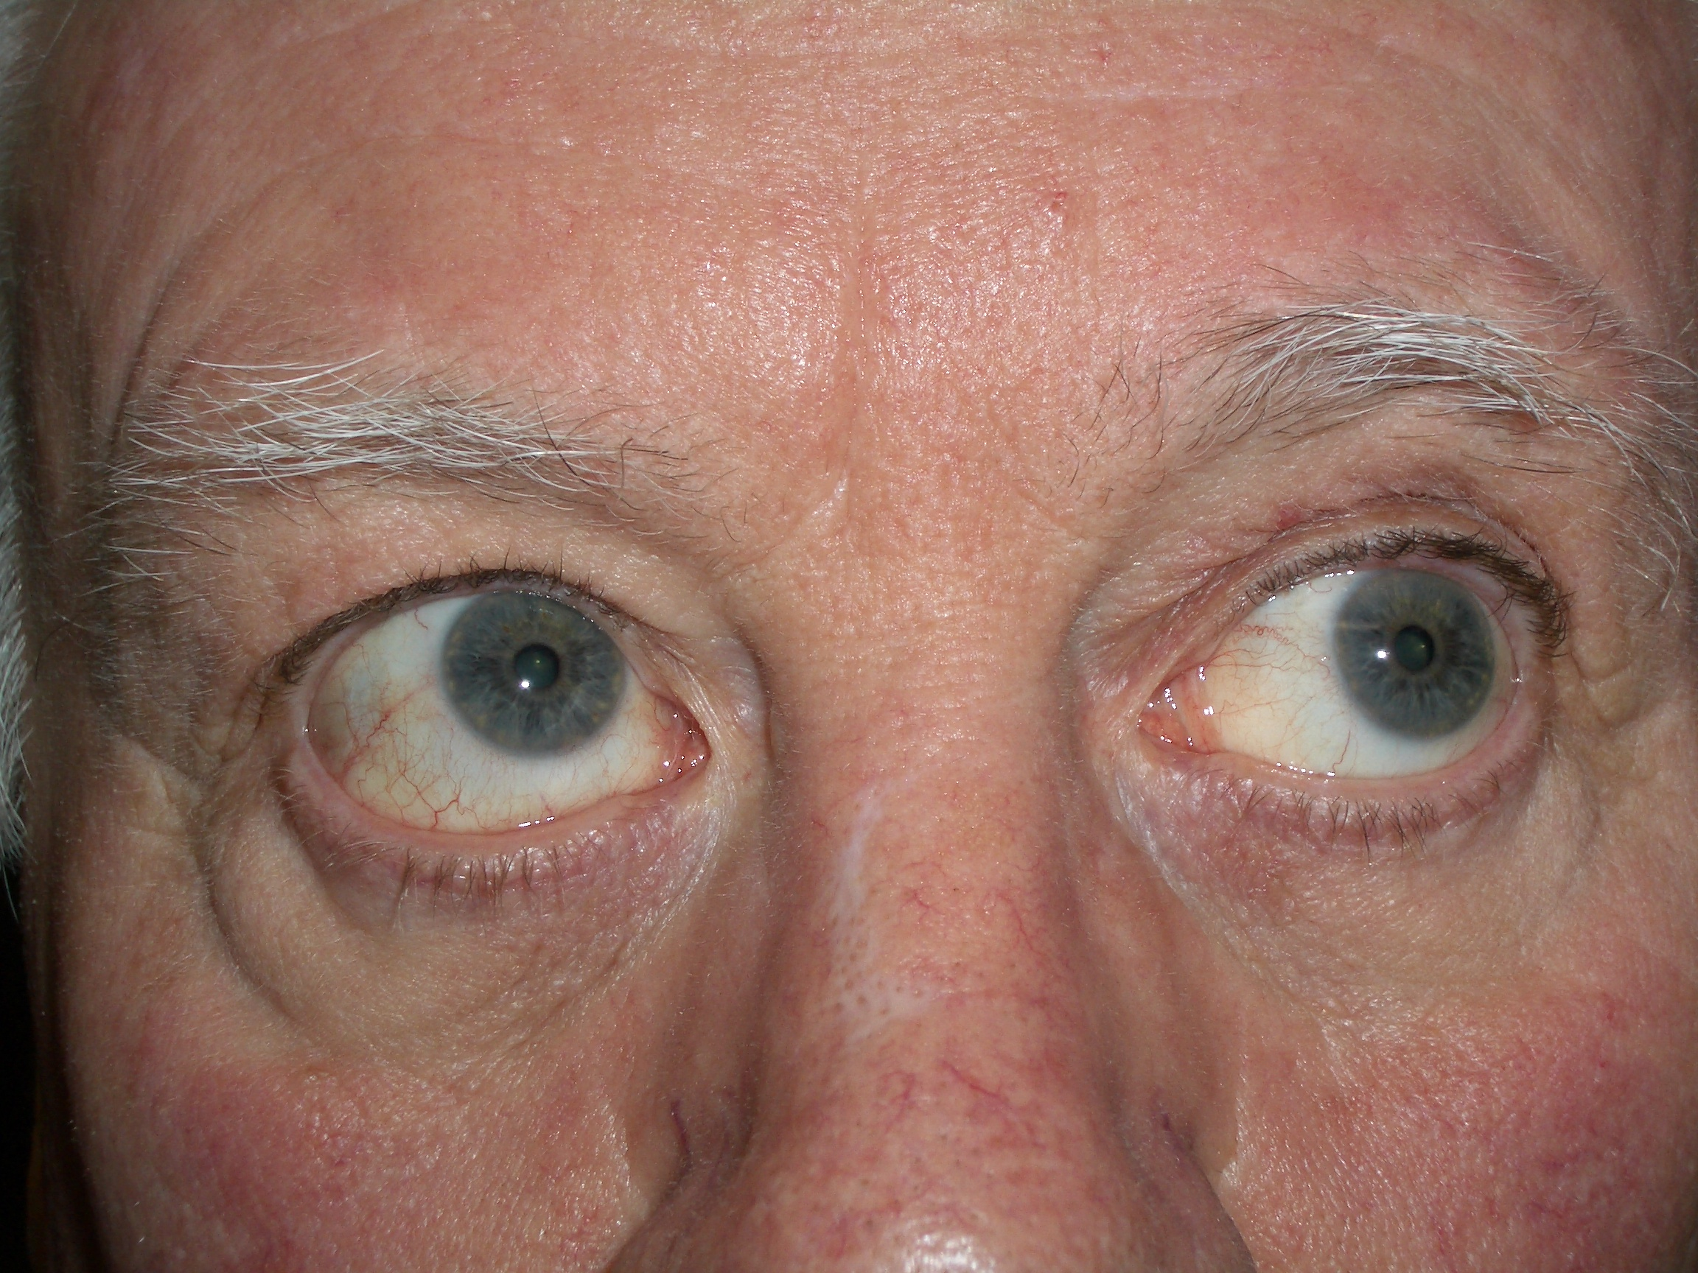
LSR slippage
Sometime between weeks 5 & 8 things went awry.
Now c/o diplopia on L gaze.
LHypo on LG

Slide 8
L
Lhypo on LG
LSR slippage
Up right 0 |  | Up left RH 16 2w later: 20
Right 0 | Primary RH 8 2w later : 14 | Left RH 20 2w later: 25
Down right LH 1 |  | Down left RH 14
OM: LIO+, LSO-, RIO+ | 7Δ BDRE small range single vision | Titmus 400”
Notes:
Q2: on the OM :isn’t the RIO + is due to fixtaion duress and the blame is LSR-?

Slide 9
KE – re-operation
FINDINGS:
LSR was found 7.5 mm from original insertion
LSO caught up in insertion
SURGERY:
LSO bluntly dissected away from LSR insertion
LSR advanced to ~3mm recess [after springback test at the end of surgery], 5/0 Vicryl
LIR recess 0mm, 6/0 mersilene adjustable and 5/0 vicryl ‘braces’
S/c dexa. Topical Betadine, Voltaren
Adjustment:
Looked fine – good range of SV on LG & RG, and 15-20 deg up & down. Tied off. Still good 6w later.

Slide 10
Why has the superior rectus slipped in 2nd month are surgery?

Slide 11
The SO-SR frenulun

Slide 12
The frenulum…
Can limit the amount of SR recess
Cutting the frenulum to lessen the above: now a potential location for adhesive scarring.
LK: passes small hook under SR backwards to bluntly & blindly break frenulum. Sometimes this is not good enough.

Slide 13
The frenulum (2)
The frenulum places extra tissue between the sup rectus & the globe preventing scar formation and scleral adhesion.
When vicryl hydrolyses, the muscle slips.
Query: a place for non-absorbable suture in SR recession – the changes seen between W5&8 may have been prevented

Slide 14
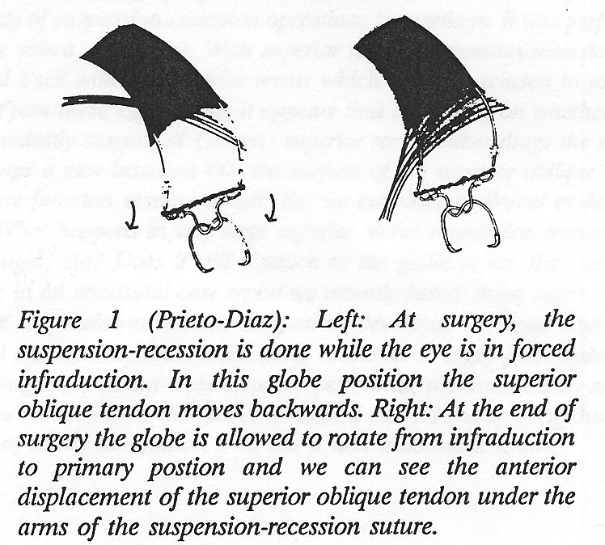
Is the SO in the way of SR-sclera union?
When the eye is infraducted, the SO is out of the way.
When the eye is in primary, the SO is very much in the way
In infraduction we can be falsely reassured that the SO tendon is no problem

Slide 15
Is there a lesson?
There are under- recognised anatomical barriers to normal SR-sclera scar formation
Watch for frenulum
Consider non-absorbable suture routinely

Slide 16


Slide 17
Different mechanisms of problems
1. Slips in month 2 because Sup obl is in the way
2. Slips on day 2
3. slips in month 2, not sure why
4. after blowout

Slide 18
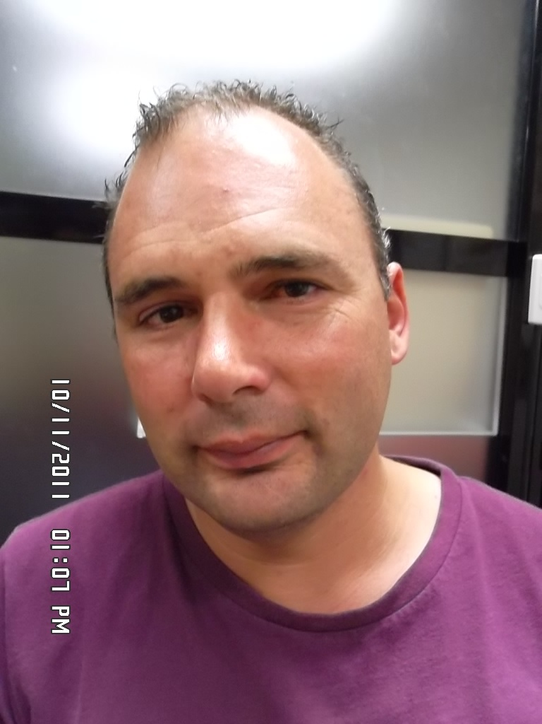
Case 2 : DH
At the age of 2yo: apparent L SOP.
HT to R 20 deg, FT to R.
Feb 1976 age 3: LIO myectomy.
Post op: consecutive RH, RSR OA
July 1976: slanted (!) RSR recess, 4mm nasal edge, 3mm temporal edge

Slide 19
DH
Right gaze | DH | Left gaze
 | LH (Left hyper in Δ)
Up R 12 | Up 0 | Up L 0
R 25 | Primary 12 | L 4
Down R 20 | Down 16 | Down L 10
 | Esotropia in Δ
 | Up 0
R 10 | Primary 8 | L 10
 | Down 20+
LSO-, LIR-

Slide 20
DH surgery #1 20 Jan2012
Findings: Tight LSR
Surgery: for LH and V- ET
LSR recess 2mm & temporal transposition [to temporal edge of insertion]; adjustable, 6/0 vicryl
RIR fixed recession 3.5mm, 6/0 mersilene
LMR recess 3, slung back from lower pole insertion, adjustable, 6/0 vicryl
RMR disinsert upper 2/3
Adjustment:
Friday night / Sat am:
No diplopia. Cover test perfect D&N. Tied off

Slide 21
Diplopia recurred within hours of leaving hospital…reversal of pre-op diplopia
Right gaze | DH | Left gaze
 | Right hyper Δ
Up 22 |  | 26
22 | 22 | 22
Down 4 |  | 14
 | Exotropia Δ
 | Up 8
 | 0
 | Down 0
LSR 3-/ RIO 3+,LIO 2-

Slide 22
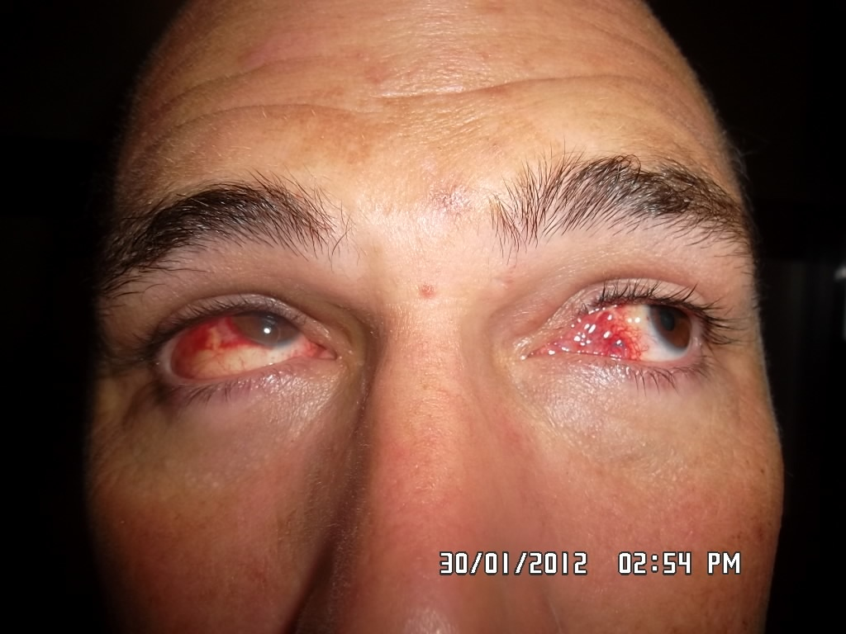
Photos 30 Jan (10d post op)
Looks like LSR UA

Slide 23
DH surgery #2 3 Feb 2012 (
Findings (2w postop) :
LSR 6mm from insertion (had rec 2mm)
RIR 10mm from limbus (had 3.5mm fixed rec)
Surgery:
LSR advance to insertion with 6/0 mersilene & 5/0 v
Adjustment:
6pm Friday: single vision
9am Saturday: same. Tied off

Slide 24
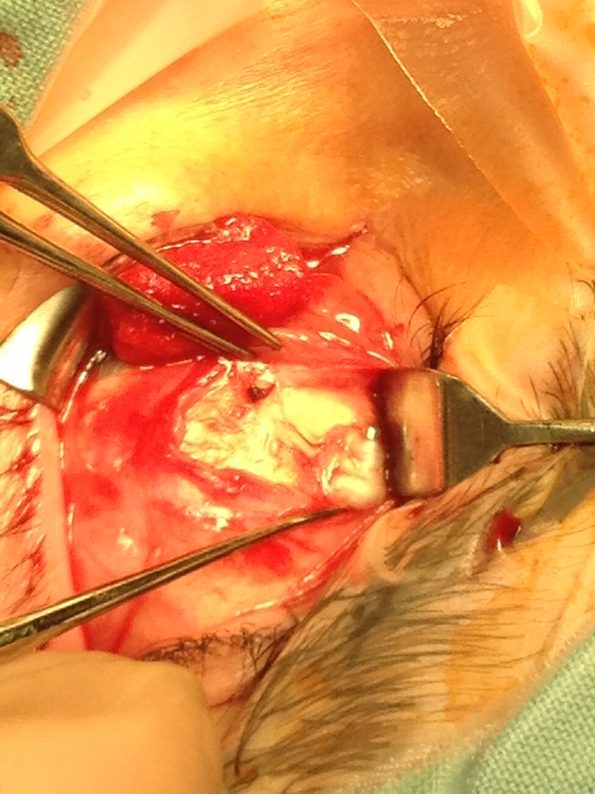
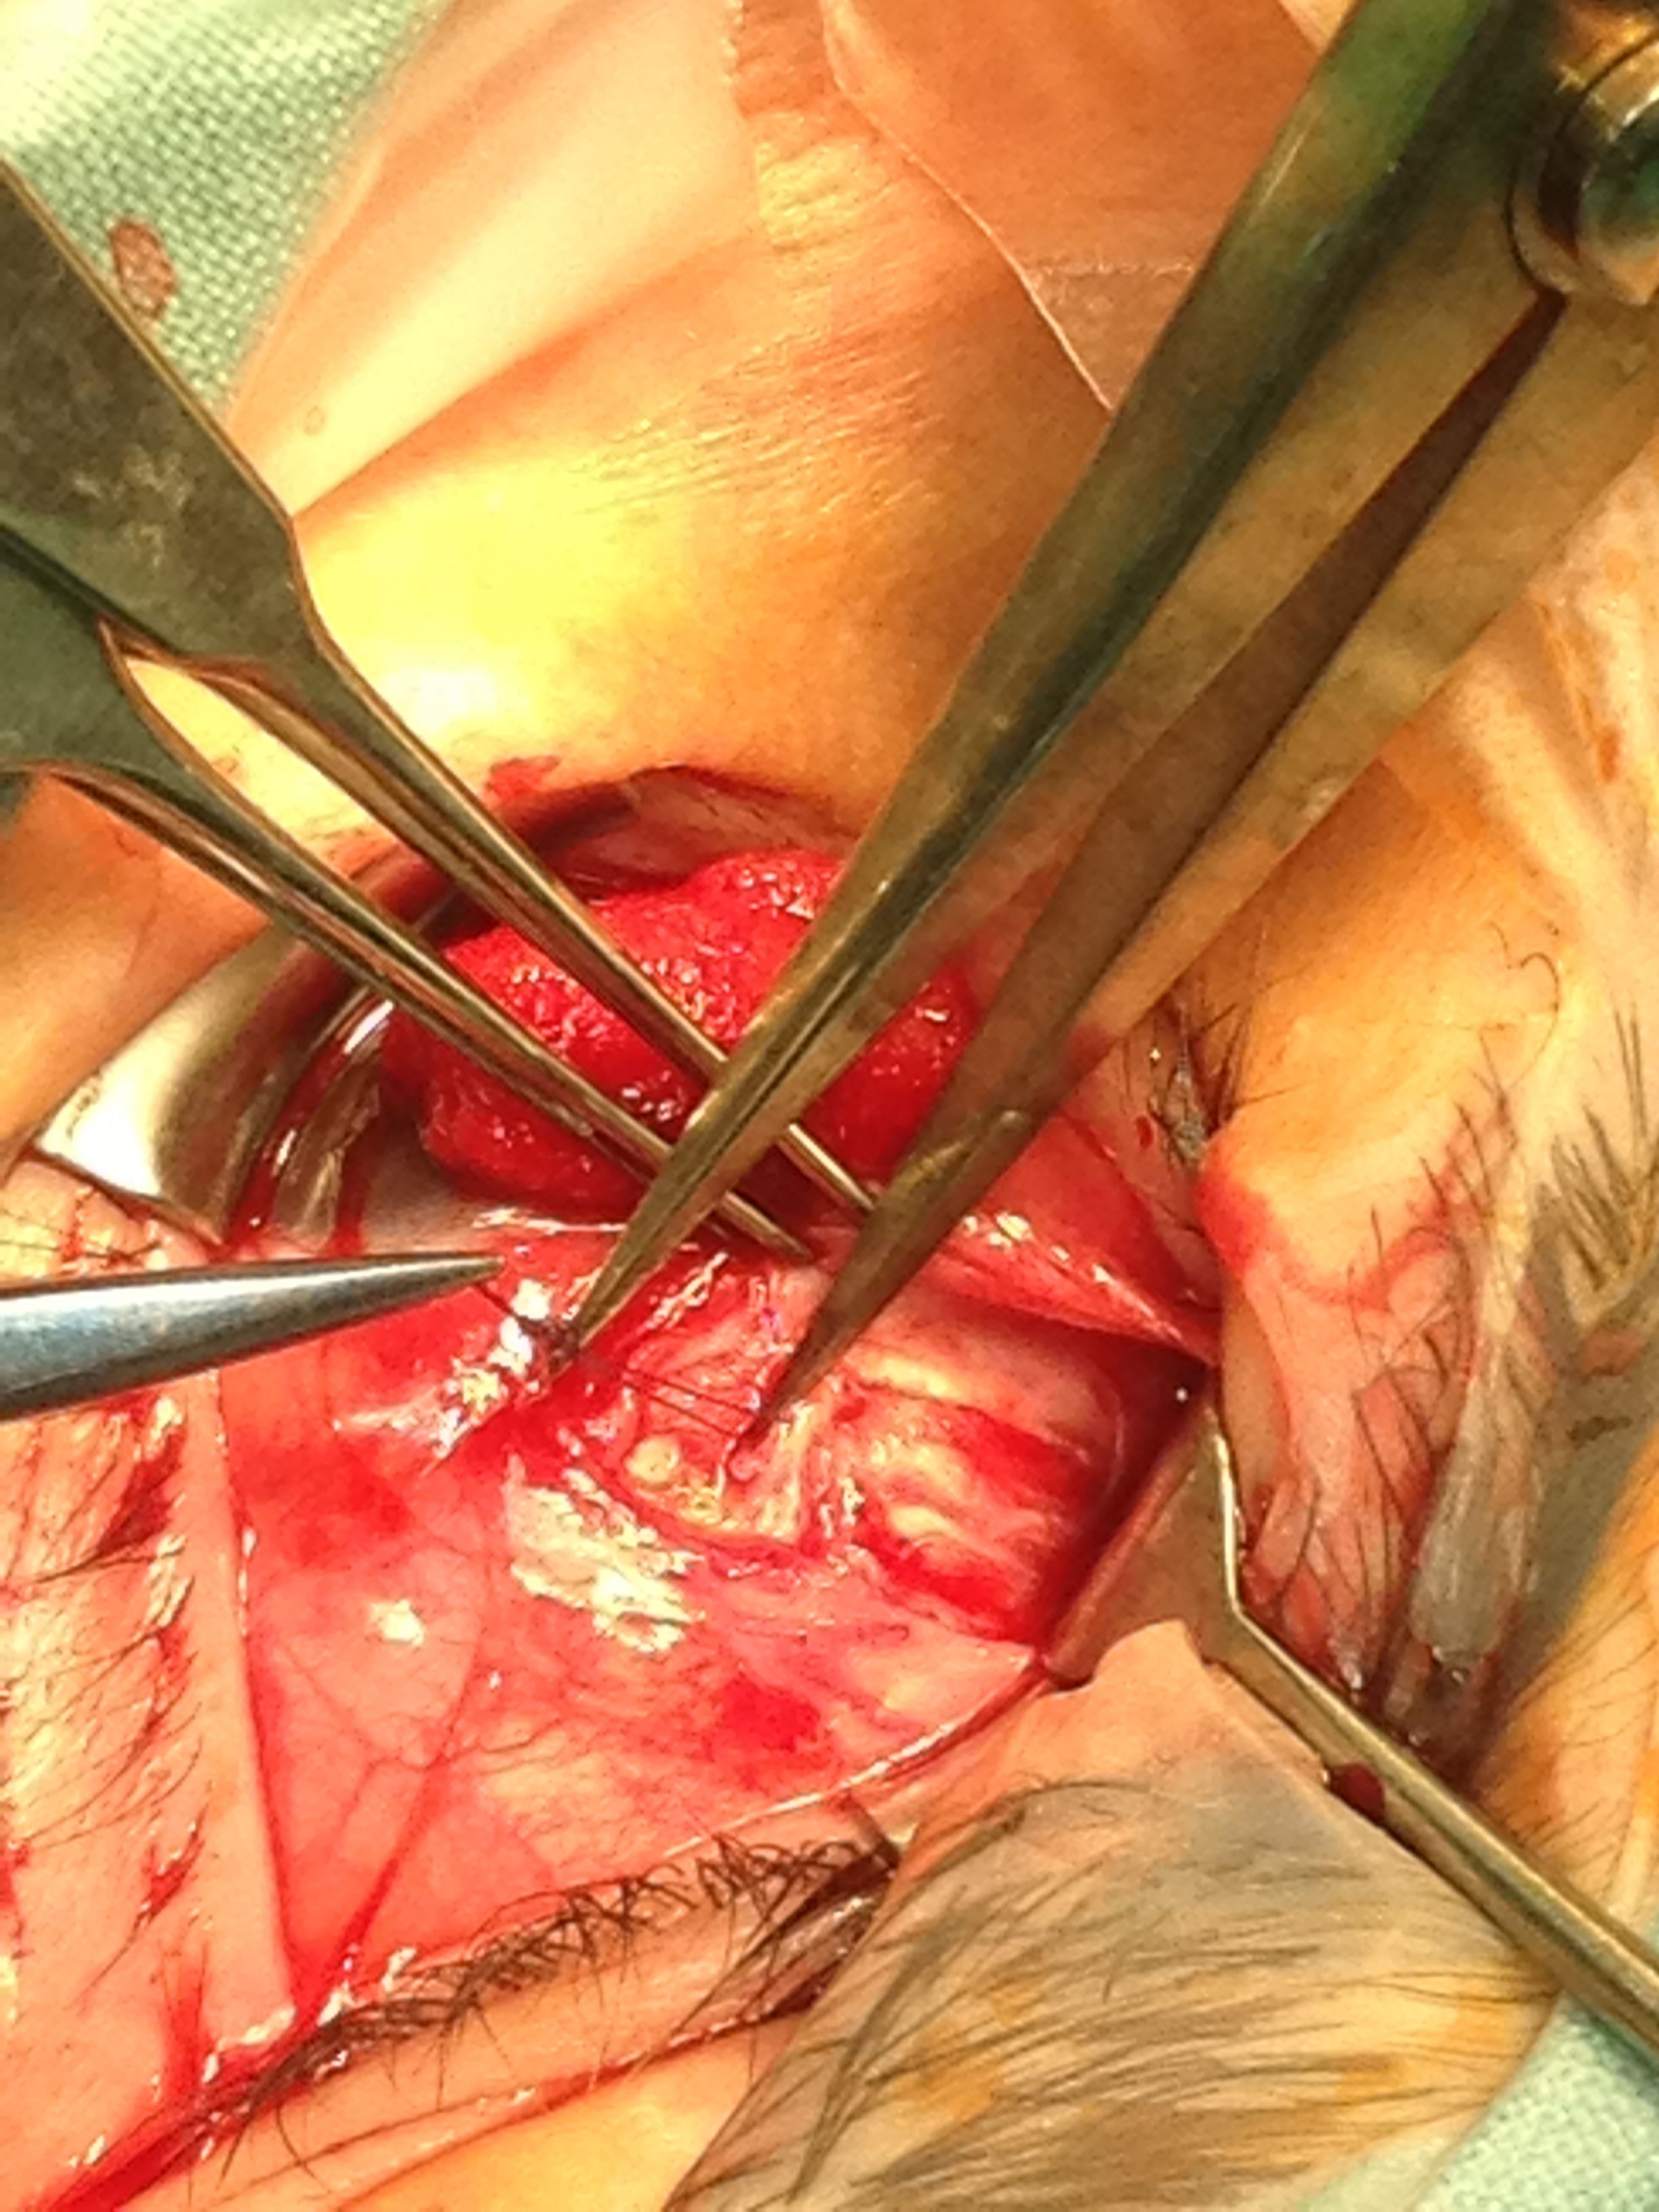
The slip knot is in place 6mm from
the original insertion
The knot
original
LSR insertion
LSR

Slide 25
Possible mechanism:
LSR had slipped 6mm overnight before I saw him, & adhesion to frenulum had prevented the LSR from ‘taking up the slack’.
It did ‘take up the slack’ ~24h after the surgery

Slide 26
Is there a lesson?
Is superior rectus recession with adjustable and an absorbable suture less reliable than:
1. best guess fixed recession with non-absorbable suture?
2. best guess fixed recession with non-absorbable suture, with plan to re-operate on D7 as a routine for an imperfect result? [Cossari delayed insertion]

Slide 27
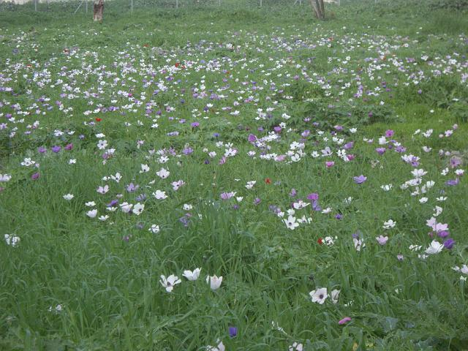

Slide 28
Different mechanisms of problems
1. Slips in month 2 because Sup obl is in the way
2. Slips on day 2
3. Slips in month 2, not sure why,
4. after blowout, and after surgery #4 is still not OK

Slide 29
#3. Slips in M2, not sure why
67 yo with vertical diplopia 7-8 yrs
2 episodes head injury 45 yrs ago
MRI: atrophic RSO
Wears progressively increasing Δ
 | Right Hyper
Up R 5 |  | Up L 8
R 12 | Primary 14 | Left 18
Down R 14 |  | Down L 26

Slide 30
Surgery
Findings: RSR a little tight, RSO not floppy
Surgery:
RSR recess 2mm, 6/0 V, adj
LIR: resect 3mm, recess 6mm with 6/0 mersilene.
5/0 V also sutured through muscle / insertion [‘braces’]
Next morning:
Vertical Fusion Range @ Arms Length BD R8, L5
Range Single good to R & down, less to L & up.
Sutures tied off

Slide 31
Diplopia recurs
 | Left hyper
8 |  | 6
12 | 10 | 6
5 |  | -2
Has SV with 8^ BD RE prism
3w later: has intermittent single vision without prism,
and wears prism most of the time

Slide 32
I have photos on D1 after surgery and week 8-9 that I will prepare as ppts

Slide 33
Lesson to learn
M2 slippage probably due to SO being in the way of proper SR- sclera union
Would be better with Mersilene -would not have happened

Slide 34
Different mechanisms of problems
1. Slips in month 2 because Sup obl is in the way
2. Slips on day 2
3. slips in month 2, not sure why
4. after blowout

Slide 35
Case #4: HB
Detailed course too complex for a short talk.
The RECURRENT SLIPPAGE OF LSR was possibly compounded by:
1. Contralateral B/O #
complex mechanics – probable muscle belly damage, possible nerve damage and possible ‘flap tear’ near insertion
These complex mechanics in the injured eye cause very incomitant squint, and have complex secondary effects on fellow eye
2. Polydoctoring (3 squint VMOs so far)

Slide 36
What have I learnt?
SR is not a friendly muscle
SO is very interesting, but quite a nuisance
Non-absorbable sutures may have prevented the bad results presented today

Slide 39
Superior rectus slippage
It is important to separate the SR/SO connection (frenulum) when you do SR Rc and especially when you transpose. Have some slides of the anatomy –anything in Wright’s atlas?...in Parks’ section in duane’s?..in Rosenbaum’s book?- I have wright atlas at home, - of frenulum … simple anatomy maybe?
If you do not separate it, then the SO drags with the SR and can lead to possible non-adherence on a hang back.

Slide 40
Case 3: HB
46 years old, healthy , smoker.
Diplopia post RE blowout fracture, due to assault (27/04/10)
R Repair of orbital floor fracture with mild displacement and no muscle entrapment (23/06/10)
First seen on Squint clinic (19/11/10):
AHP : Chin up
PCT: N 4 BOΔ R Hypo 10 Δ
D 2 BOΔ R Hypo 14Δ
  Poor RE elevation worse in adduction
  Plan: RIR Rc for presumed tight RIR
  LSR Rc for upgaze incomitance

Slide 41
Case 3: HB
46 years old, healthy , smoker.
Diplopia post RE blowout fracture, due to assault April 2010
R Repair of orbital floor fracture with mild displacement and no muscle entrapment June 2010
First seen on Squint clinic November 2010
AHP : Chin up
PCT: N 4 BOΔ R Hypo 10 Δ
D 2 BOΔ R Hypo 14Δ
  Poor RE elevation worse in adduction
  Plan: RIR Rc for presumed tight RIR
  LSR Rc for upgaze incomitance

Slide 42
HB
Detailed course too complex for a short talk.
The RECURRENT SLIPPAGE OF LSR was possibly compounded by:
1. Contralateral B/O #
If restricted RE DG from flap tear, fixation duress & Hering’s law may cause persistent excess of innervation to LIR, and tends to stretch LSR scarring
2. Contracted LIR from frequent L hypo due to [say] LSR not adhering properly
3. polydoctoring (3 VMOs)

Slide 43
HB
Date | Height | Other | Rx
Nov 2010 | LH 14 | Poor elevation R esp in aBduction | #1. Feb ‘11. RIR Rc Mersilene. LSR Rc 6/0 V
#1. 2w postop | RH 10 | Limited R depression | #2: Mar ‘11. explore:LSR slipped 8mm, adv 5mm, adj
#2: 2w postop | RH 3 | Happy. Some LSR UA
#2: 5w postop | RH 5, RH’ 11 | Poor L elevation. Normal CT | Fresnel – not happy
#2: 8w 29/4 | RH 16
#2: 11w | RH 20
#2: 12w | RH 20 |  | #3. May 31. LSR explored, found 9 mm from limbus - had not slipped, release of scar tissue

Slide 44
Date | Height | Other | Rx
#3. day 1 | RH 10 | LLL Retraction on attempted elevation | #4: June 22... LIR Rc. mersilen, LSR adv original insertion 6/0 V
#4. day 1 | After adj, 0 | Large range SV
#4: W3 | RH 8 | SV 80% of the time
#4: W8 | RH 12
#4: M7 | RH 12 | Needs RH 16-18 for SV
Investigation : BT’s: TFT, , AChR Abs: normal
SFEMG: normal

